Slide 1


Slide 2
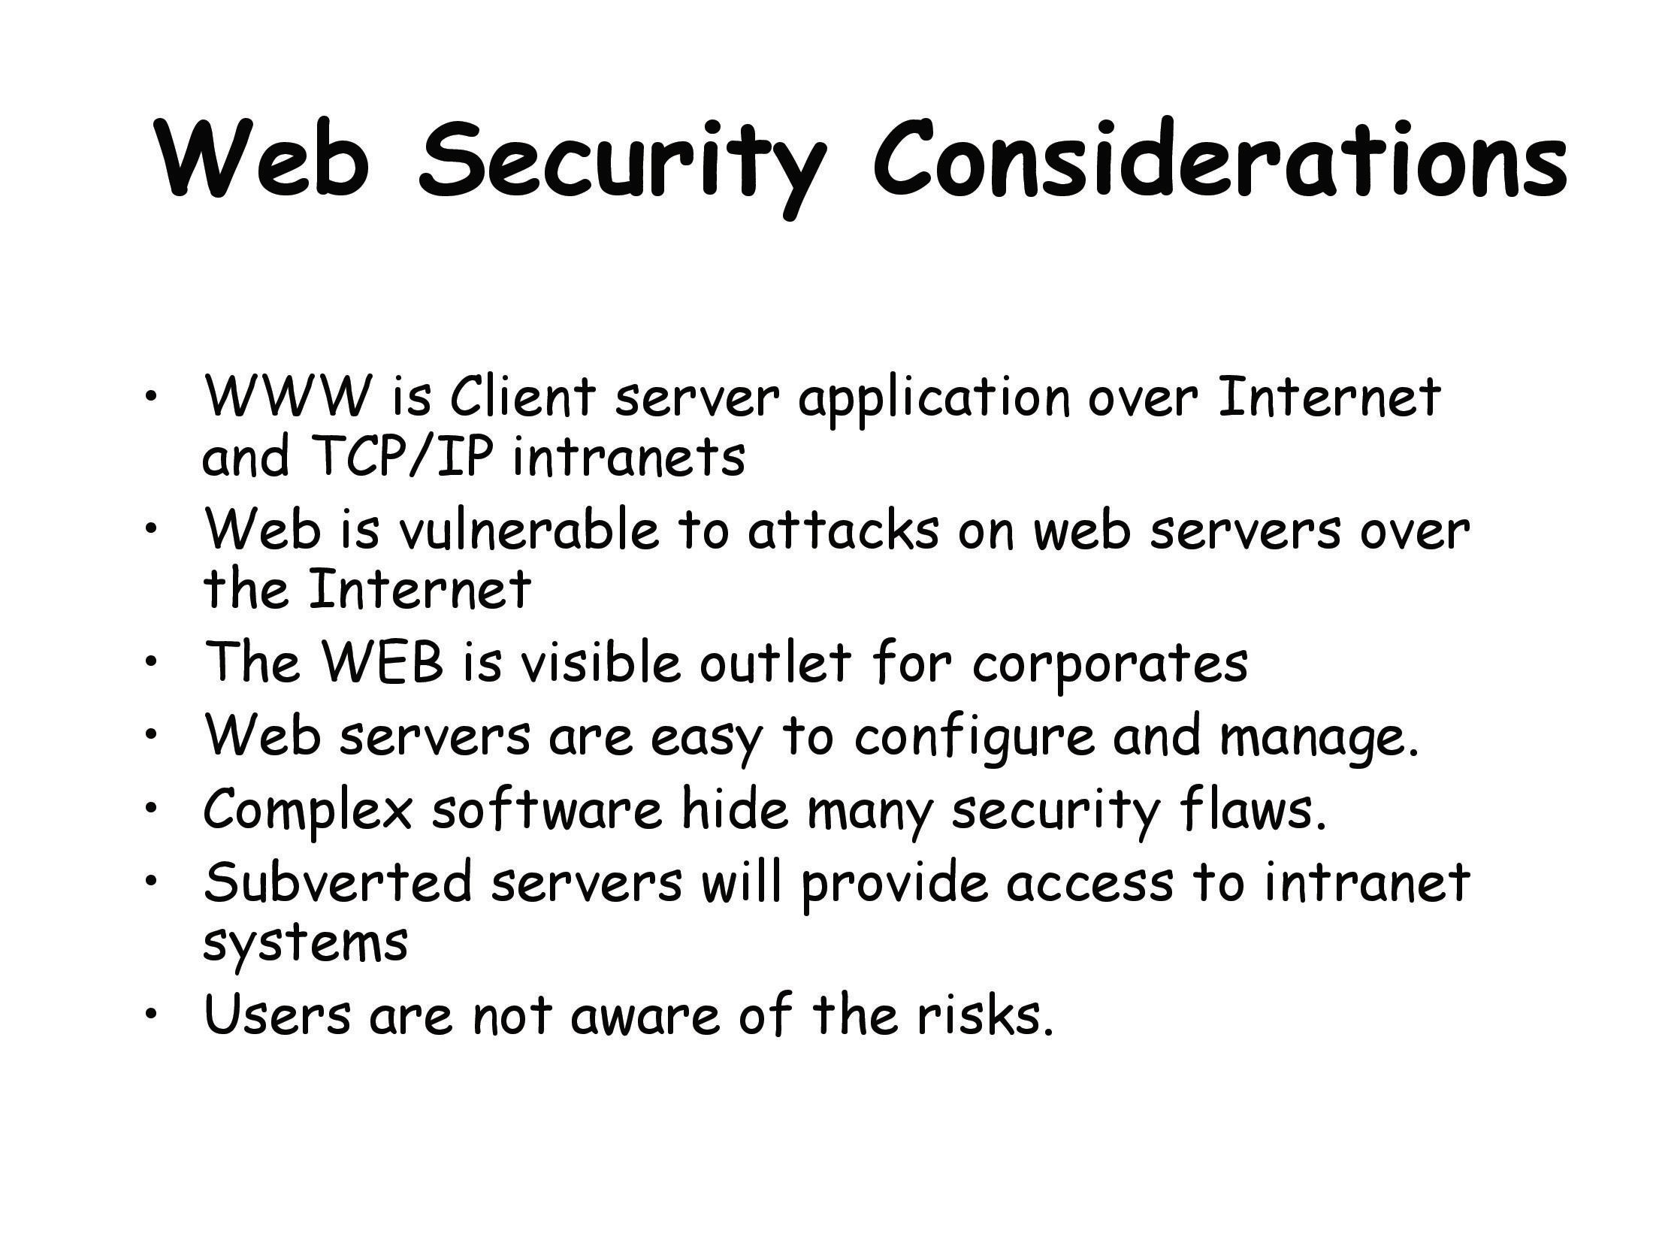

Slide 3
Web Security Considerations
The World Wide Web is fundamentally a client/server application running over the Internet and TCP/IP intranets. Web presents new challenges not generally appreciated in the context of computer and network security
The Internet is two way. Unlike traditional publishing environments, even electronic publishing systems involving teletext, voice response, or fax-back, the Web is vulnerable to attacks on the Web servers over the Internet.
The Web is increasingly serving as a highly visible outlet for corporate and product information and as the platform for business transactions. Reputations can be damaged and money can be lost if the Web servers are subverted.

Slide 4
Web Security Considerations
Although Web browsers are very easy to use, Web servers are relatively easy to configure and manage, and Web content is increasingly easy to develop, the underlying software is extraordinarily complex. This complex software may hide many potential security flaws. The short history of the Web is filled with examples ofsystems that are vulnerable to a variety of security attacks.
A Web server can be exploited as a launching pad into the corporation's or agency's entire computer complex. Once the Web server is subverted, an attacker may be able to gain access to data and systems not part of the Web itself but connected to the server at the local site.
Casual and untrained (in security matters) users are common clients for Web-based services. Such users are not necessarily aware of the security risks that exist and do not have the tools or knowledge to take effective countermeasures.

Slide 5
Web Traffic Security Approaches

Slide 6
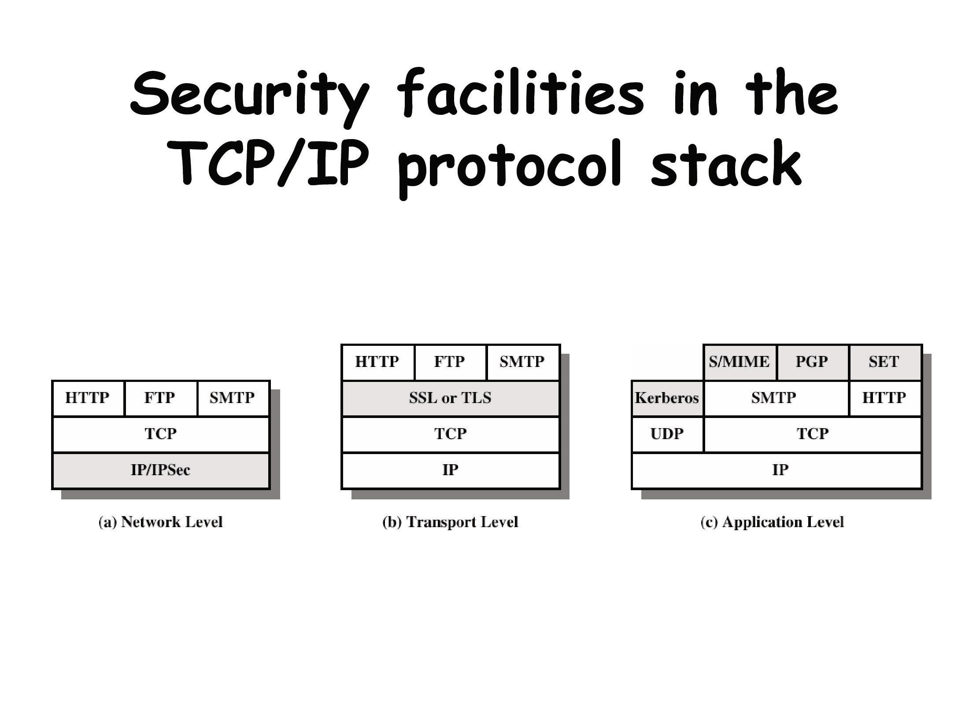

Slide 7
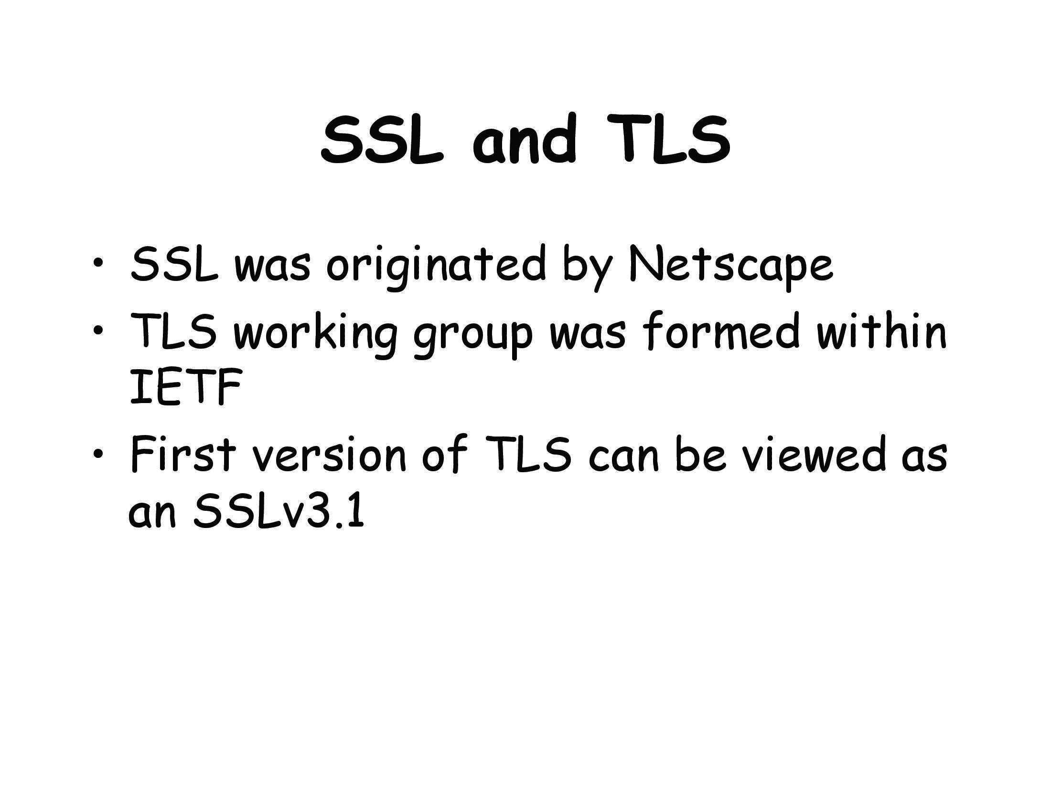
(Internet Engineering Task Force)

Slide 8
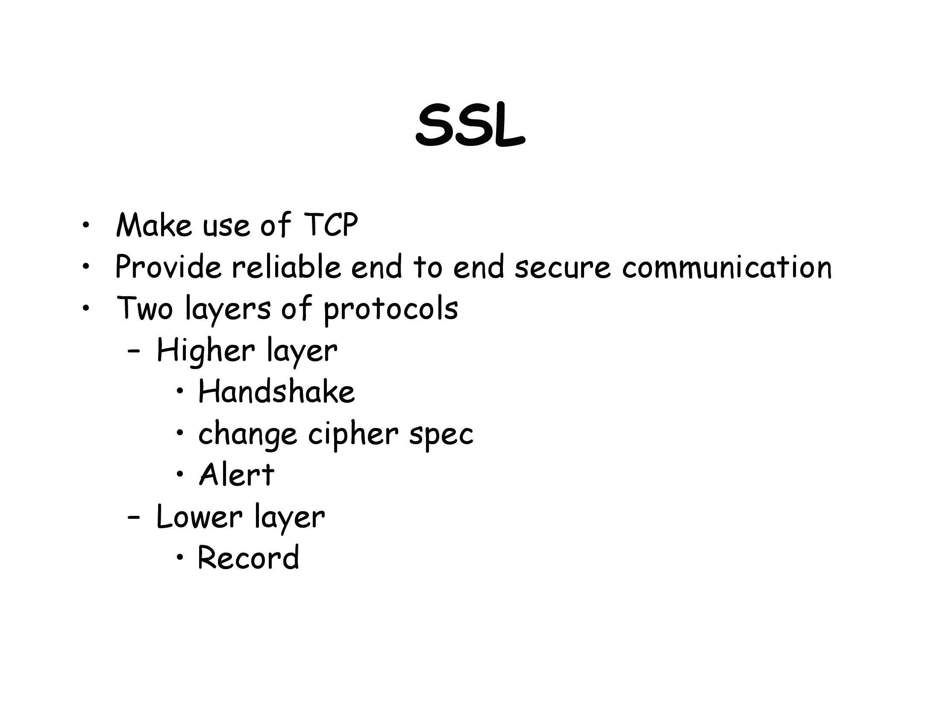

Slide 9
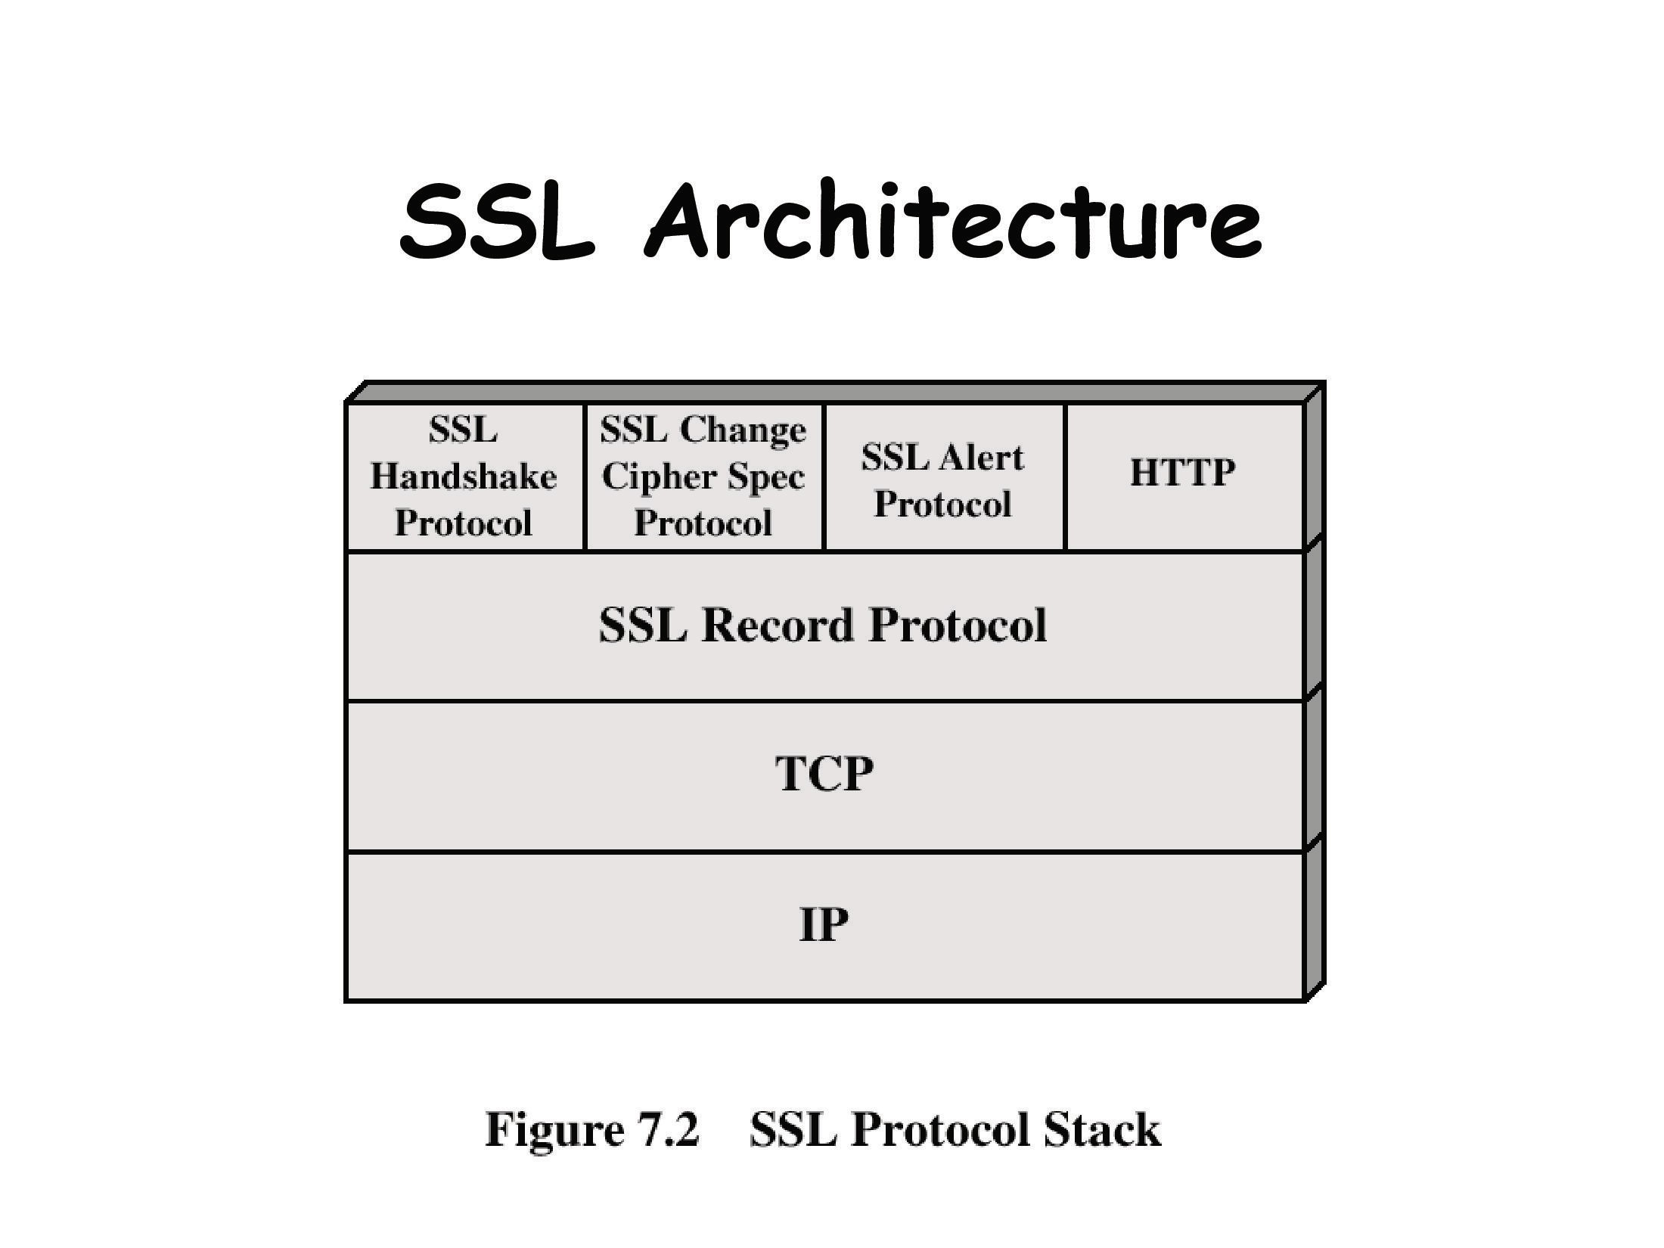

Slide 10
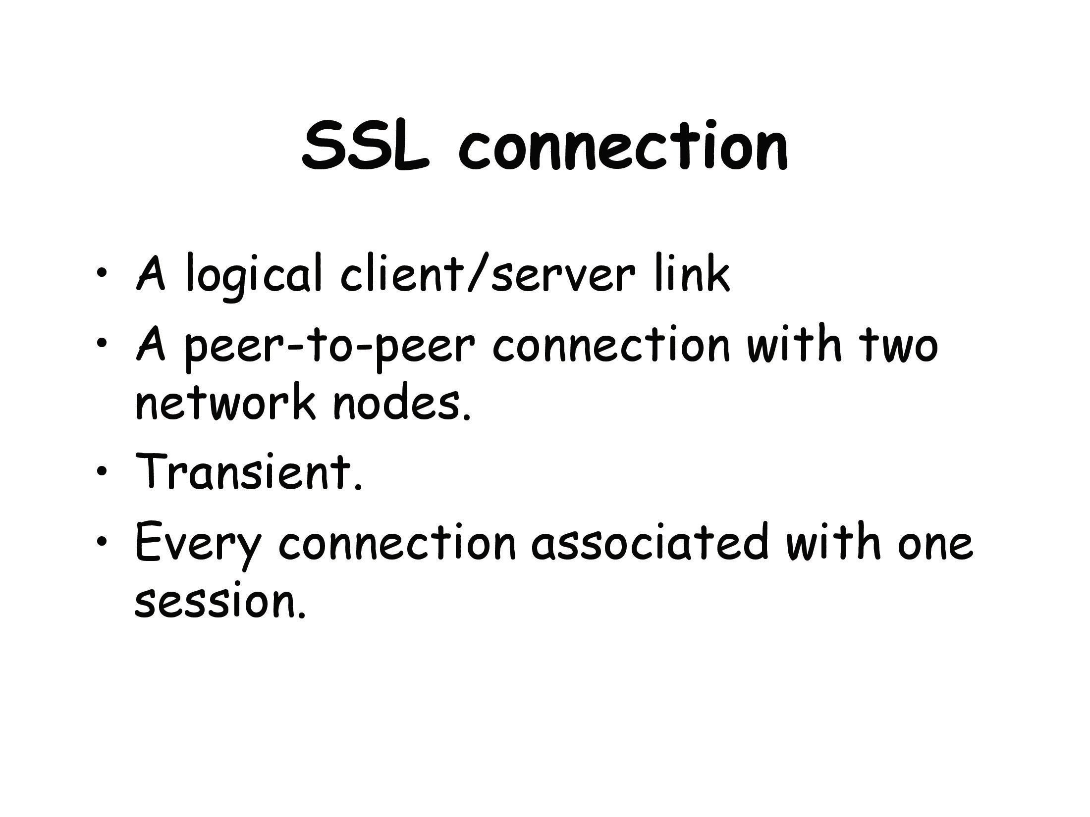

Slide 11
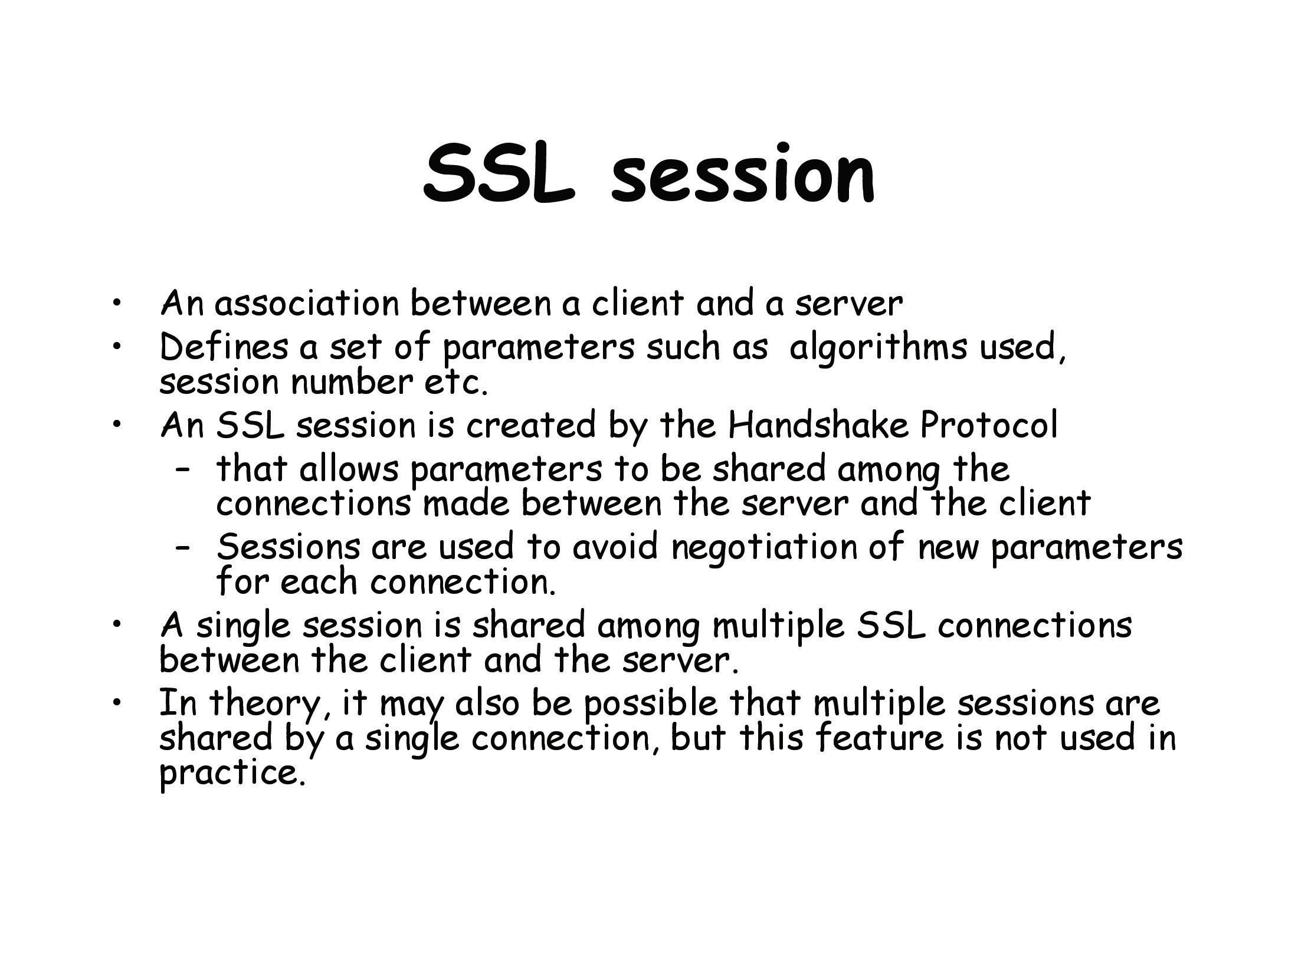

Slide 12
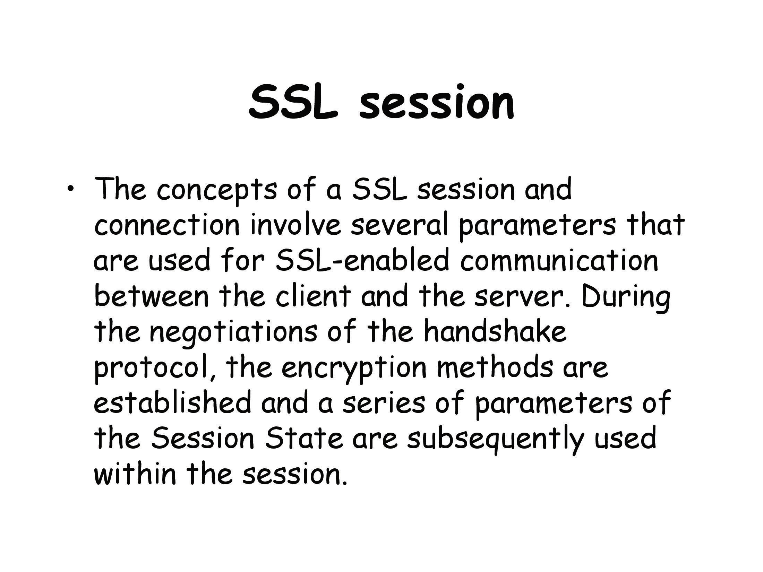

Slide 13
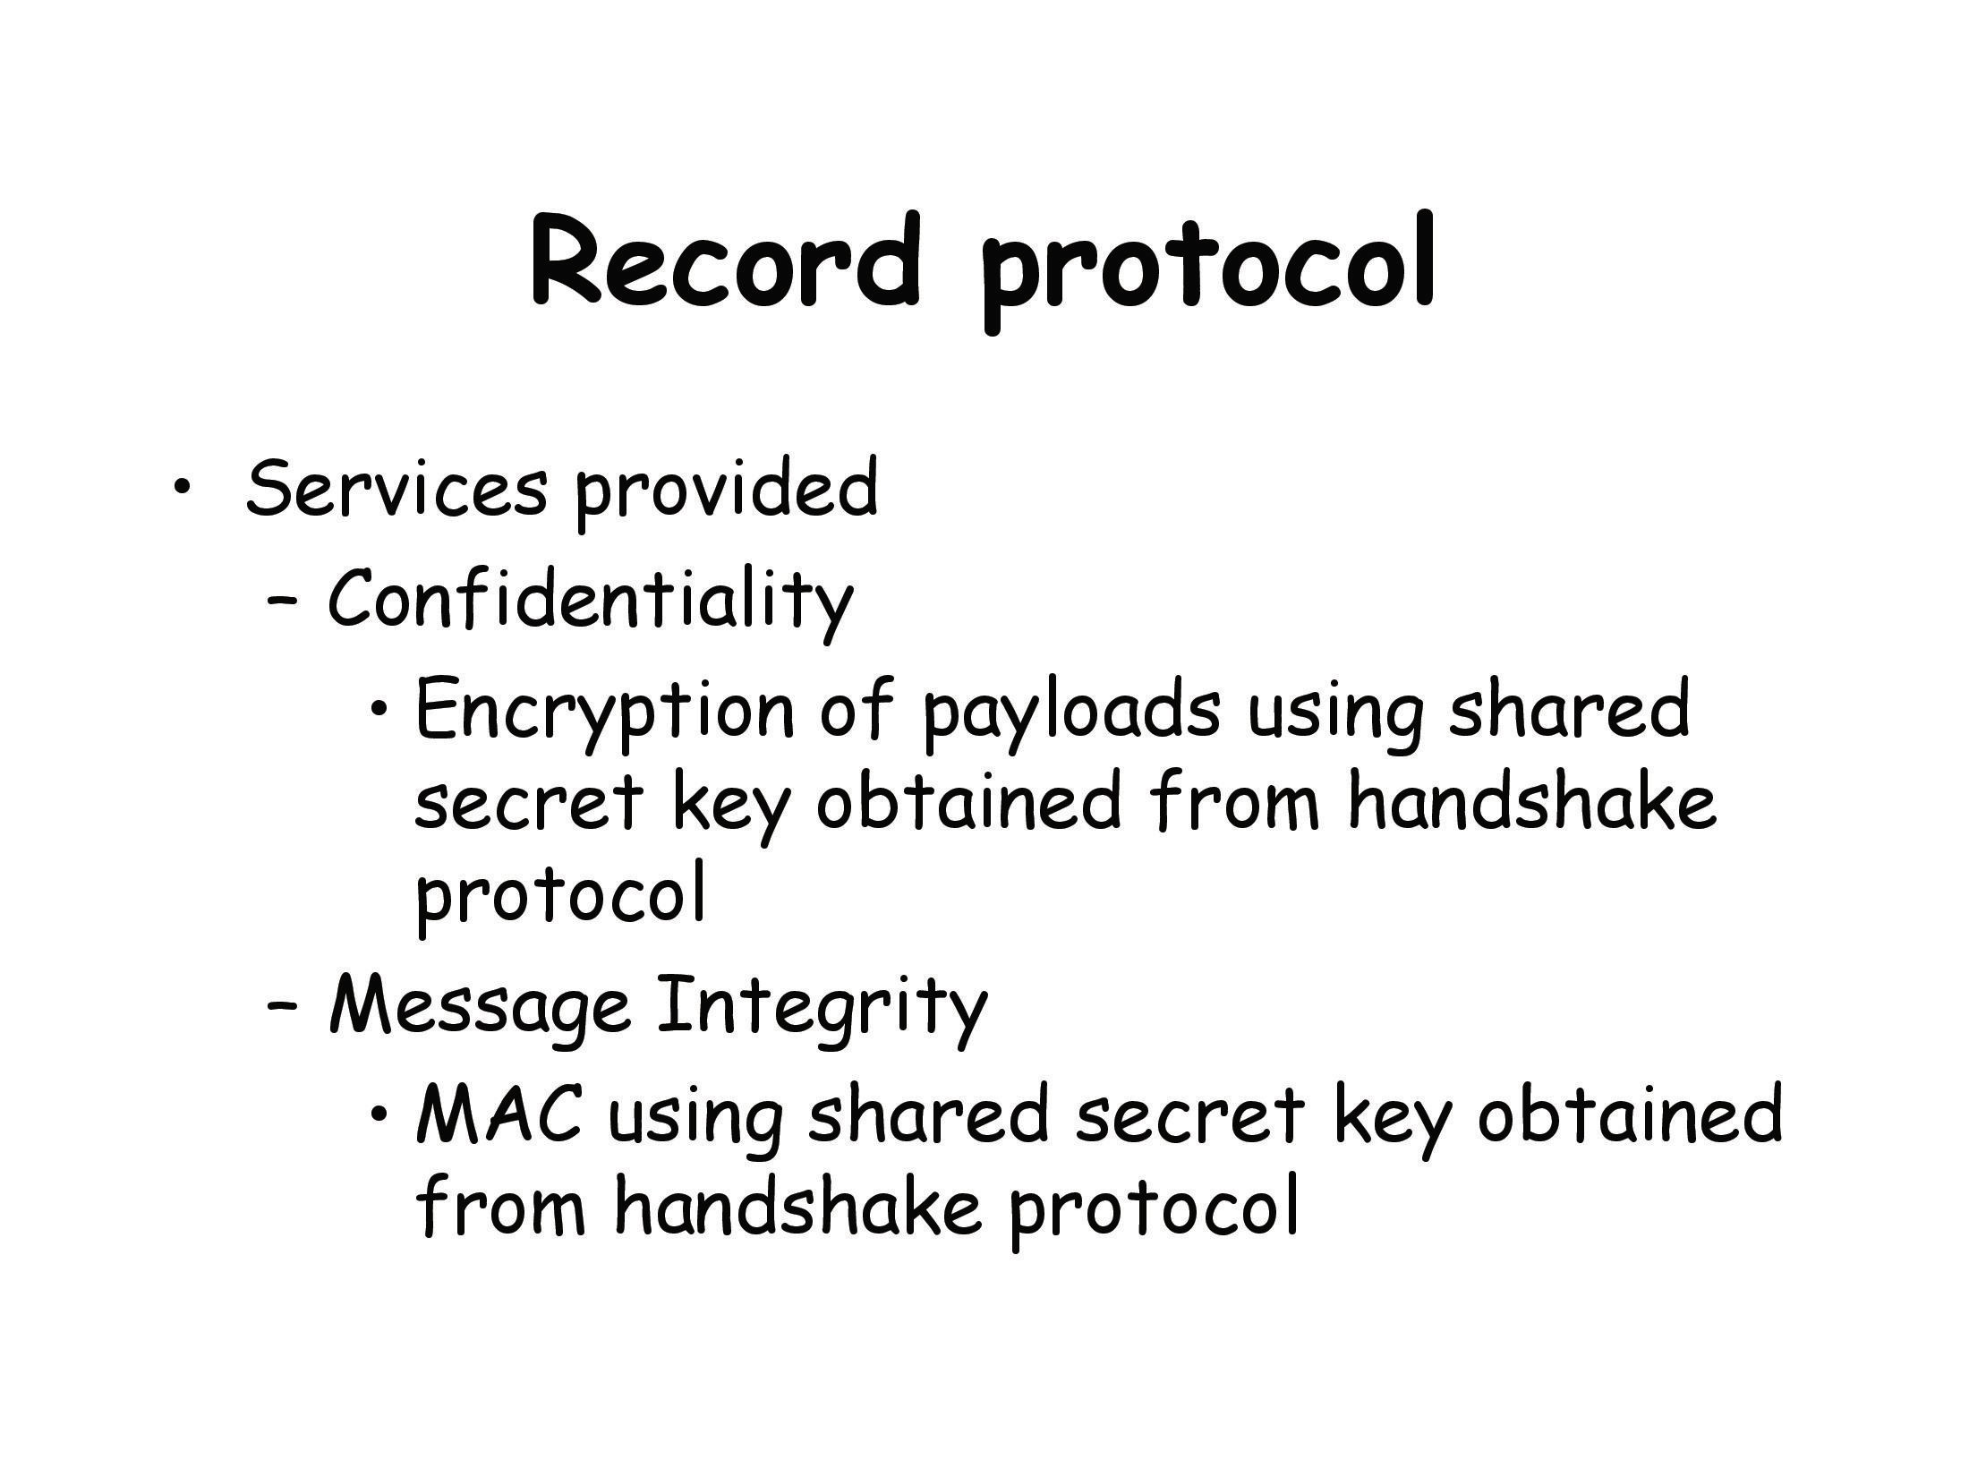

Slide 14
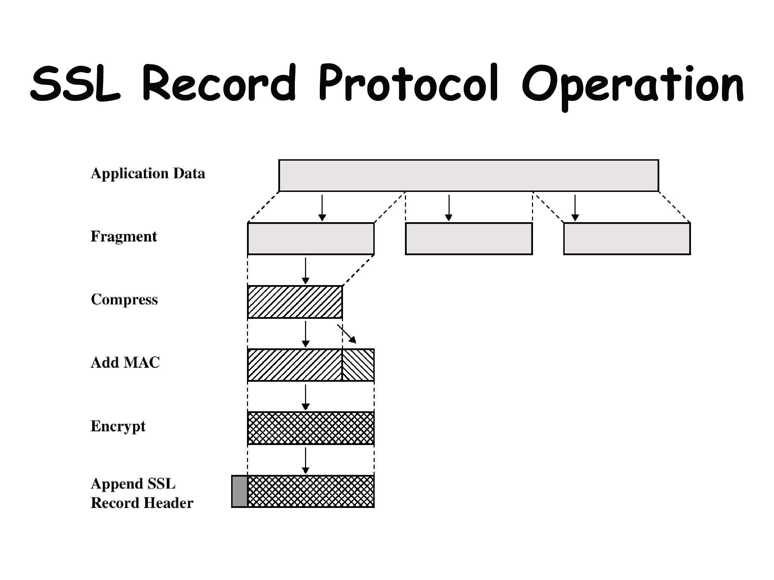

Slide 15
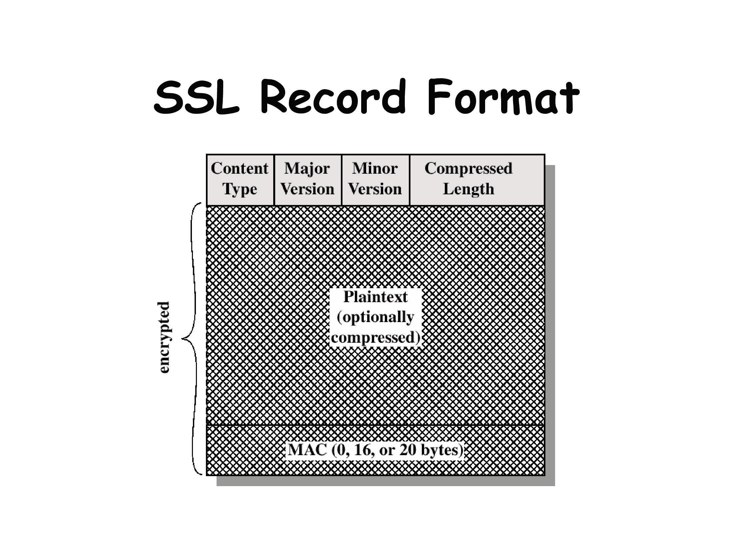

Slide 16
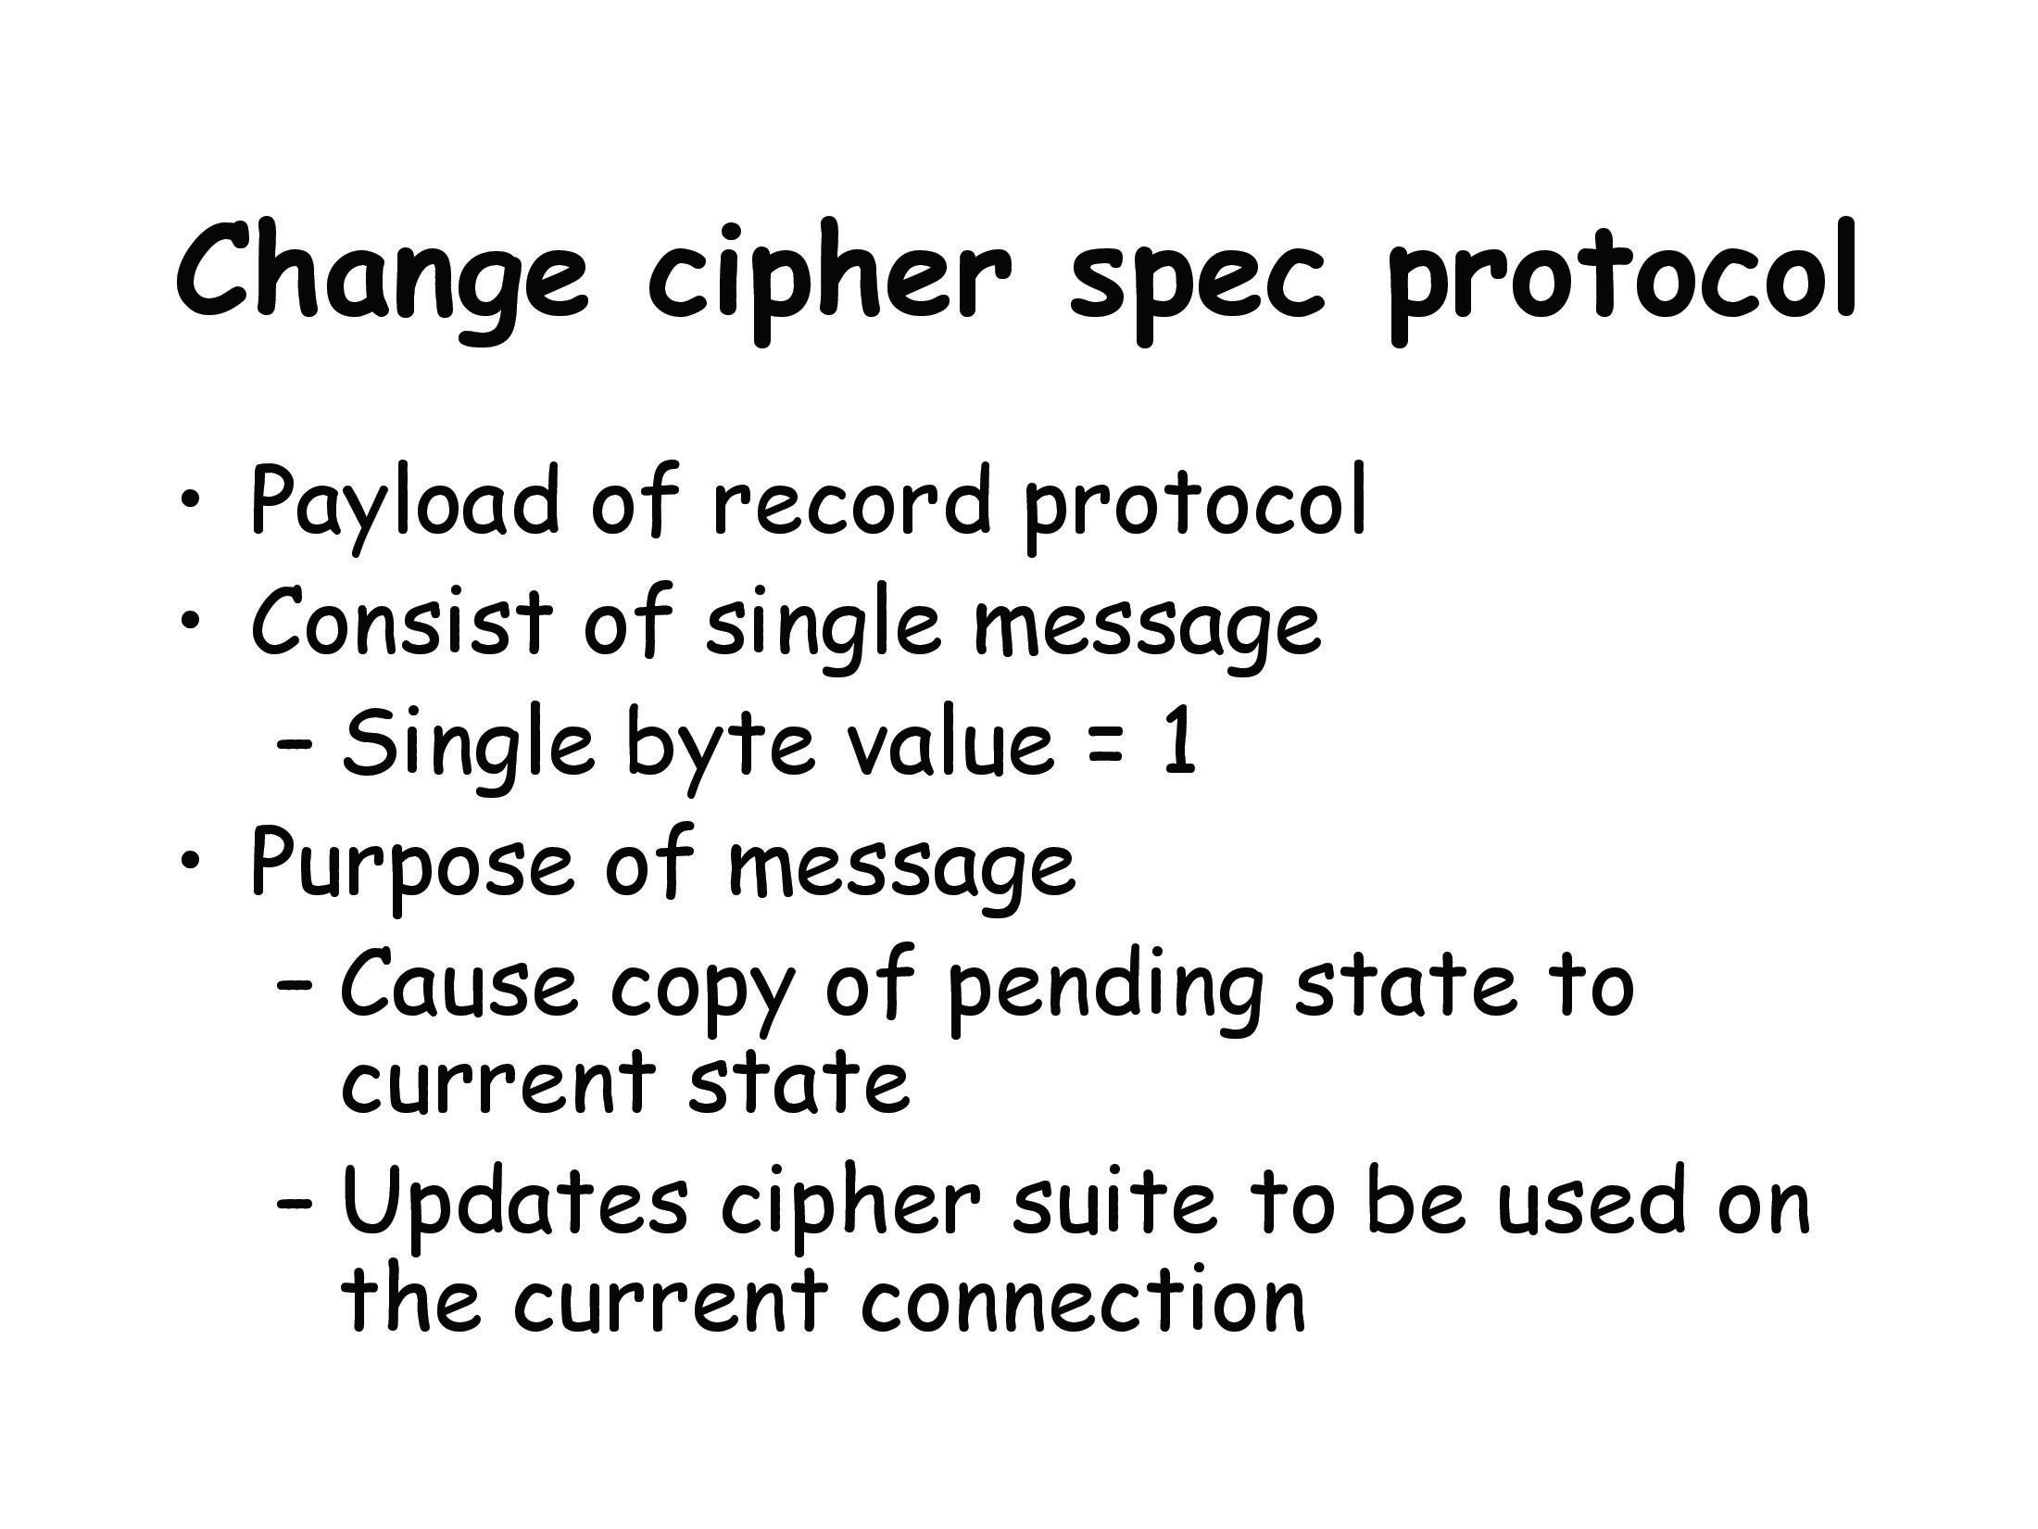

Slide 17
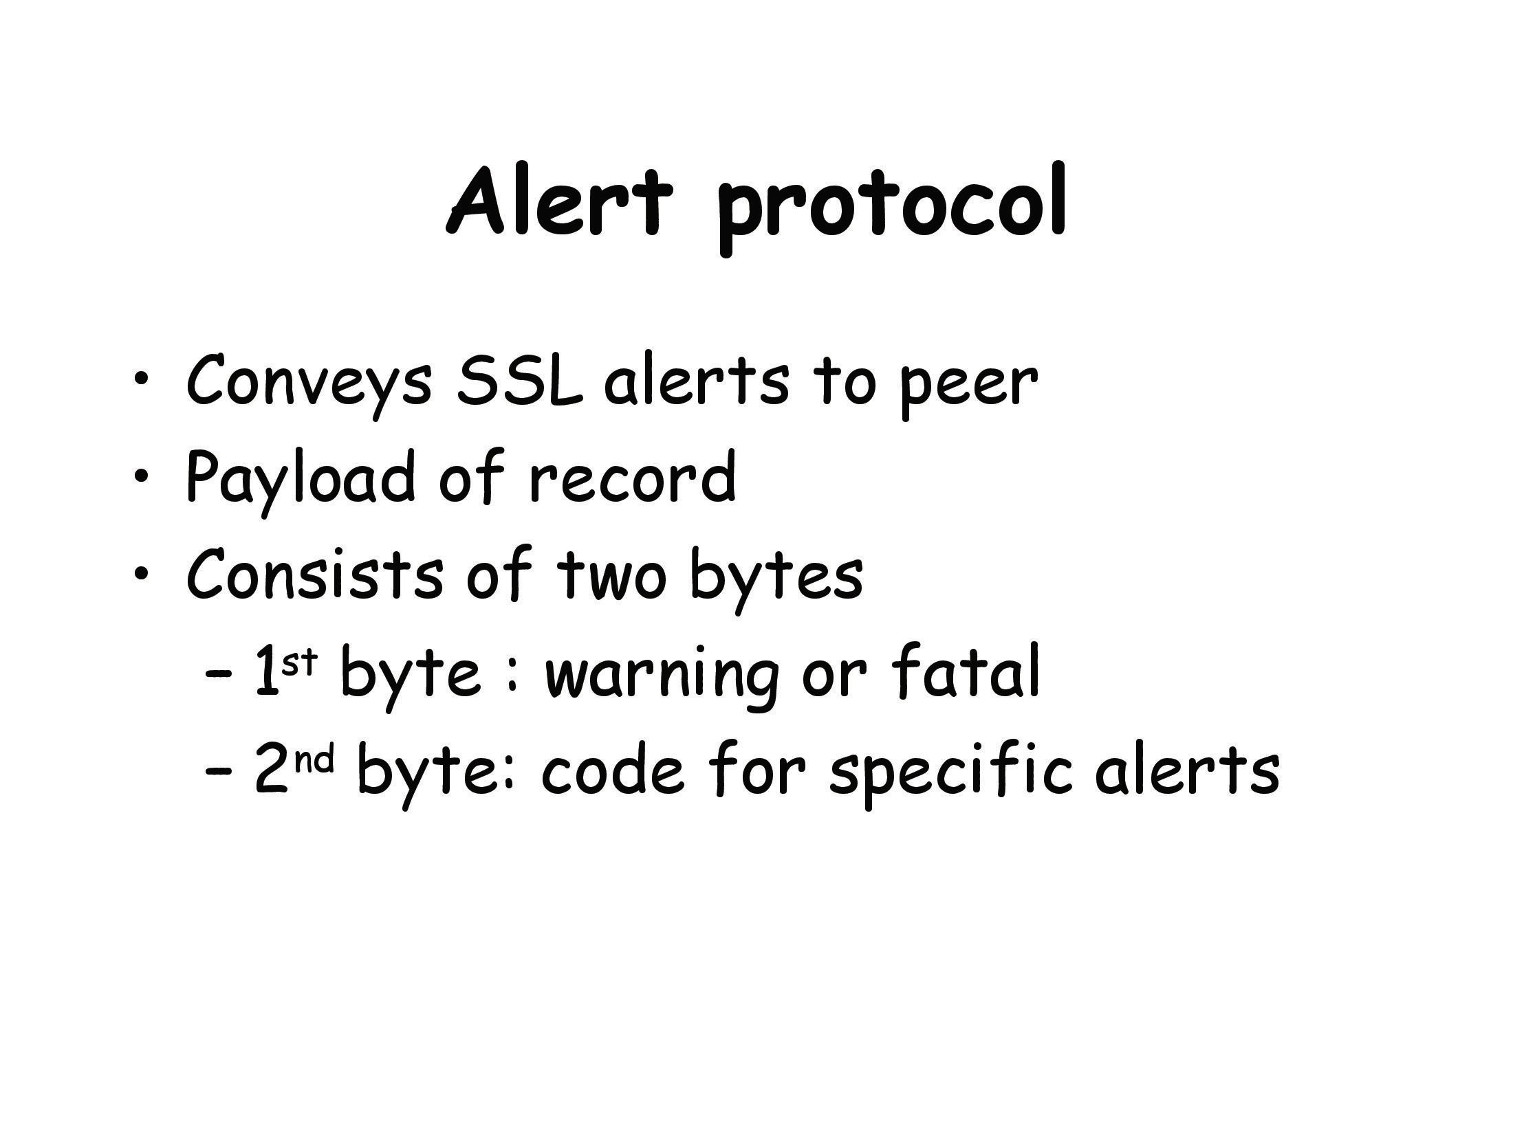
The Alert Protocol is used to convey SSL-related alerts to the peer entity. As with other applications that use SSL, alert messages are compressed and encrypted

Slide 18
Alert Protocol Examples
unexpected_message: An inappropriate message was received.
bad_record_mac: An incorrect MAC was received.
decompression_failure: The decompression function received improper input (e.g., unable to decompress or decompress to greater than maximum allowable length).
handshake_failure: Sender was unable to negotiate an acceptable set of security parameters given the options available.
illegal_parameter: A field in a handshake message was out of range or inconsistent with other fields.

Slide 19
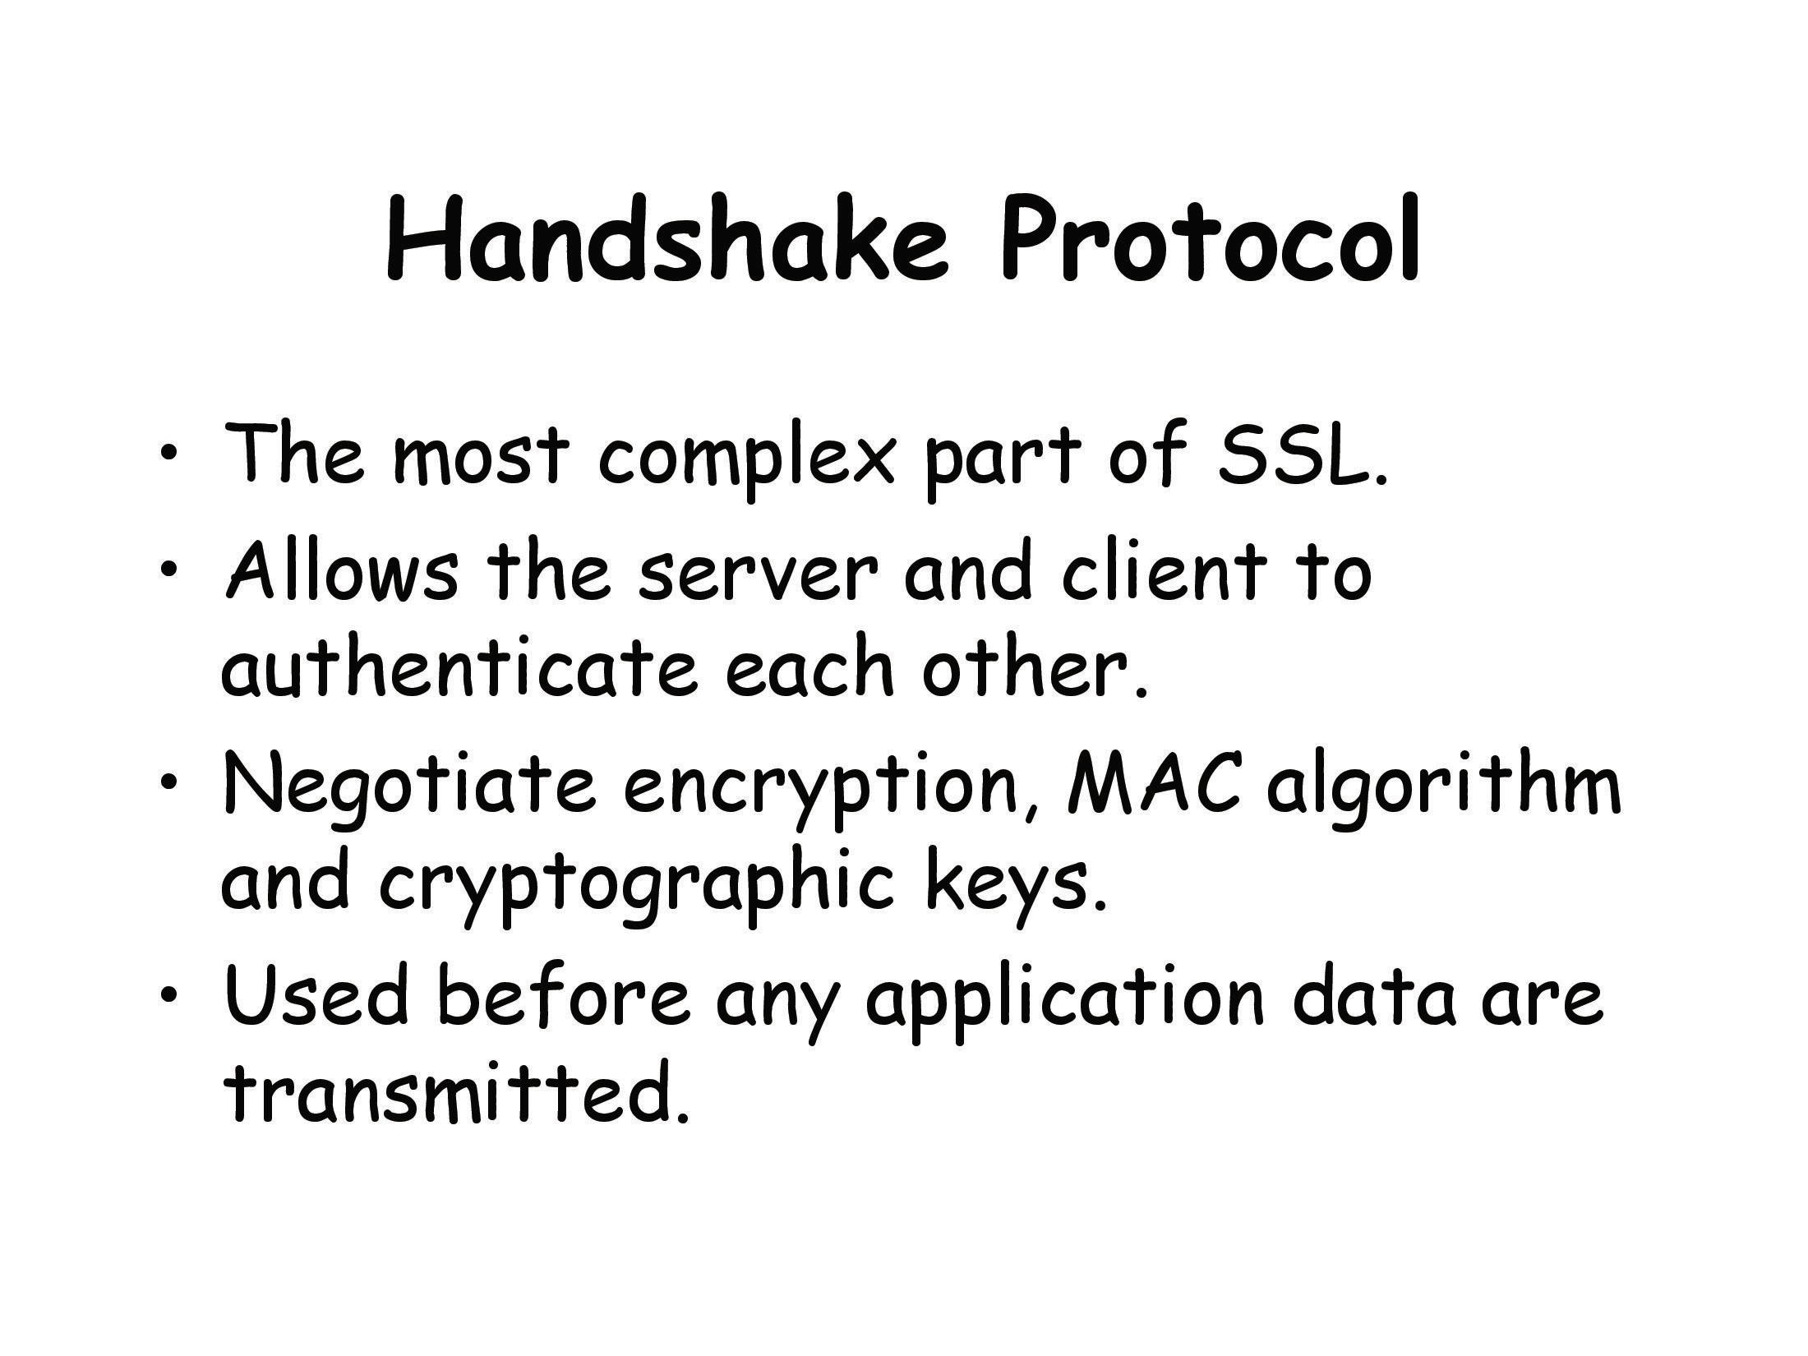

Slide 20
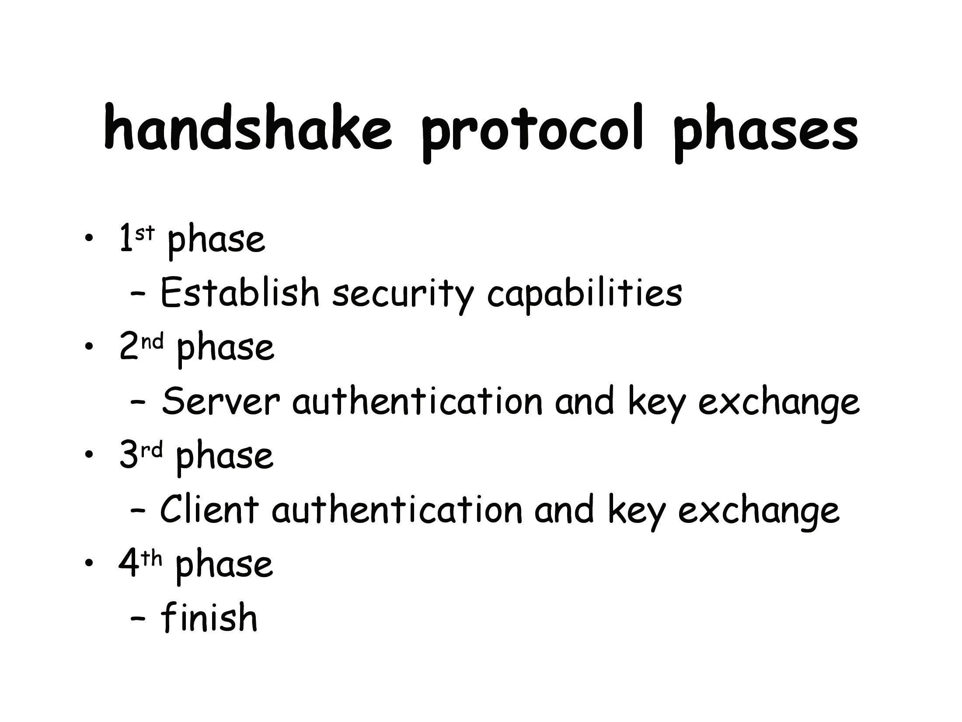

Slide 21
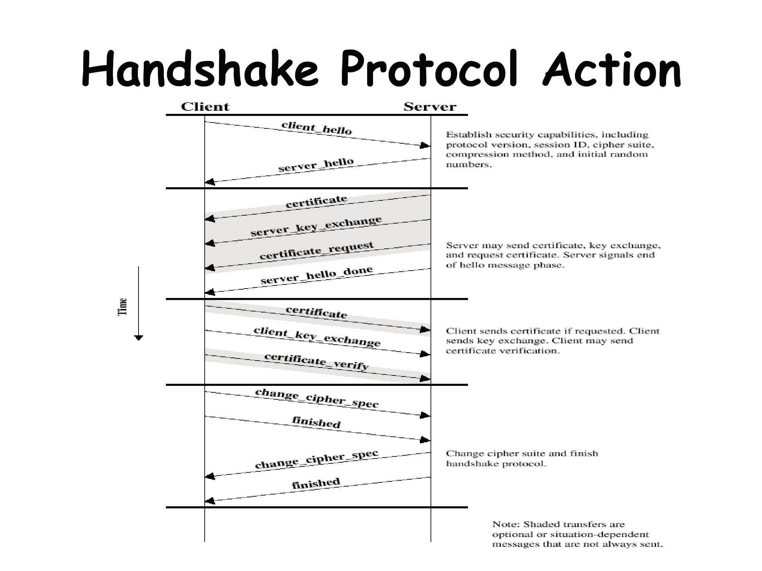

Slide 22
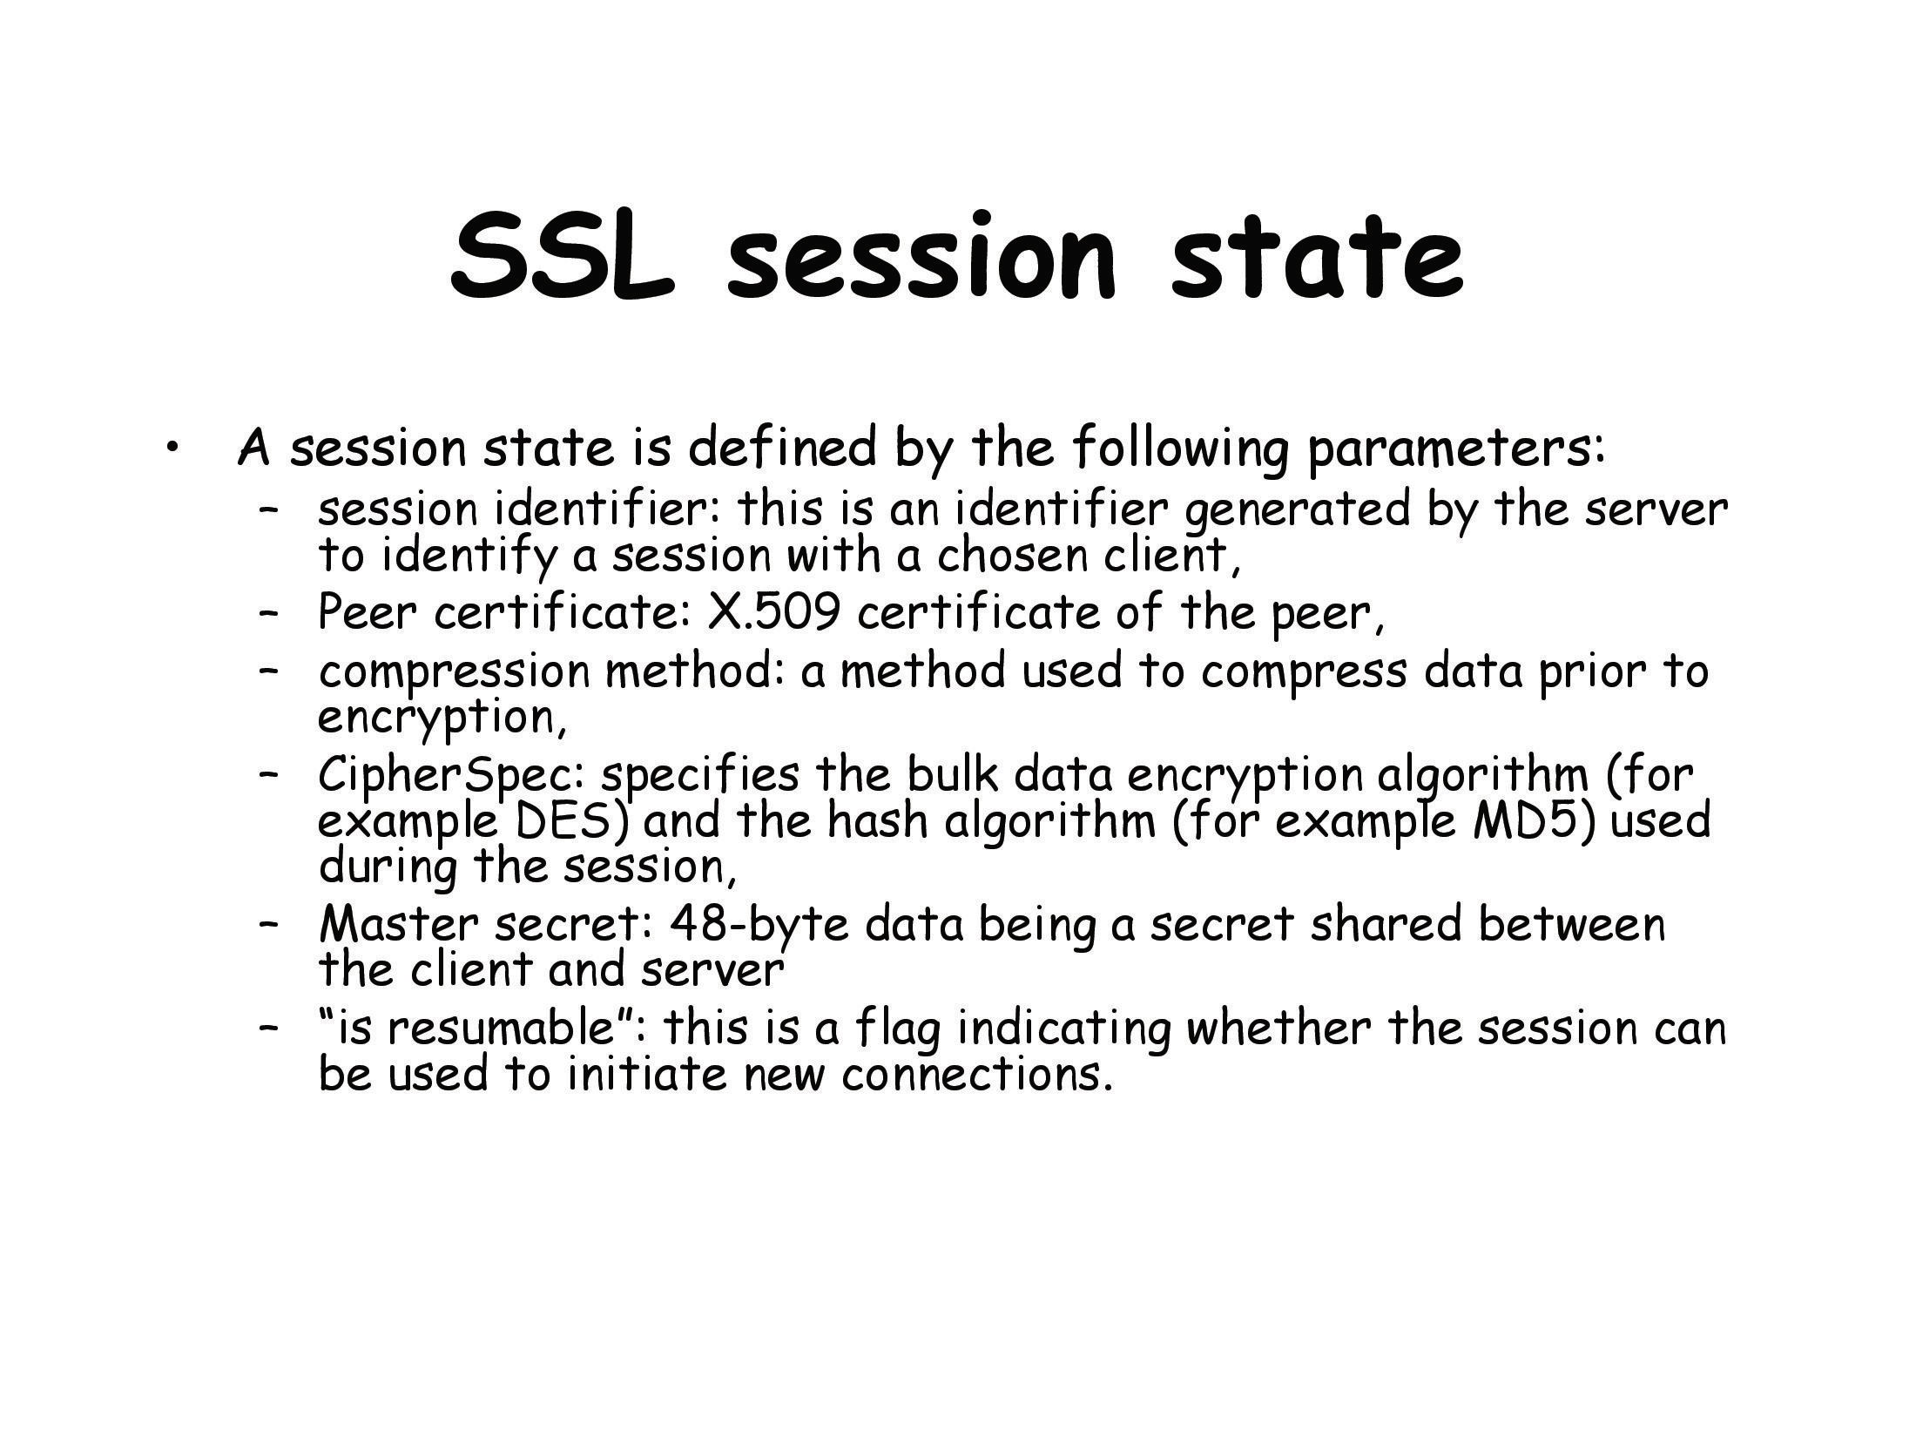

Slide 23
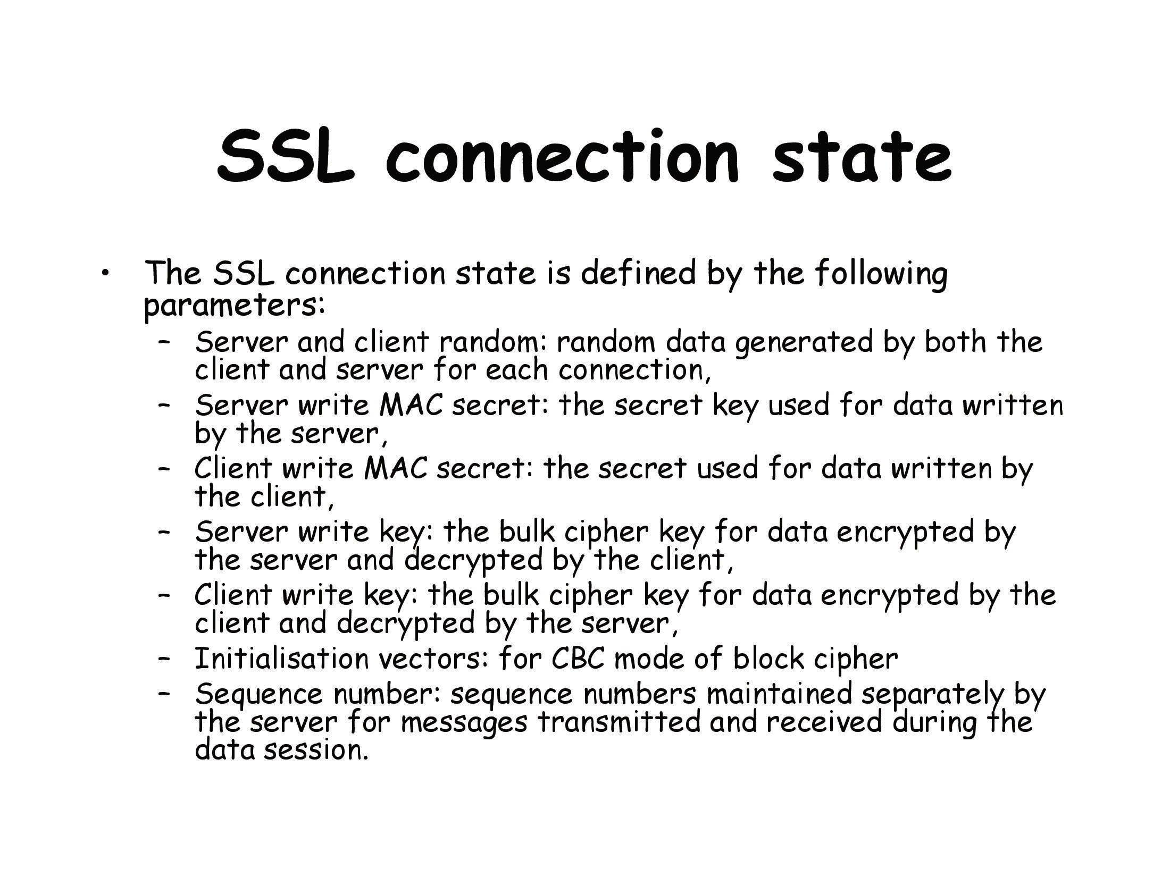

Slide 24
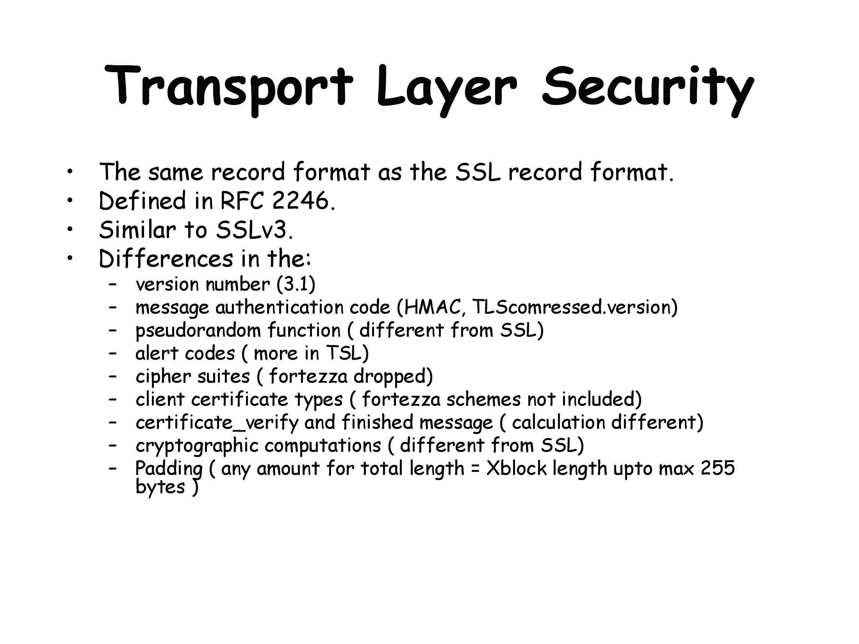

Slide 25
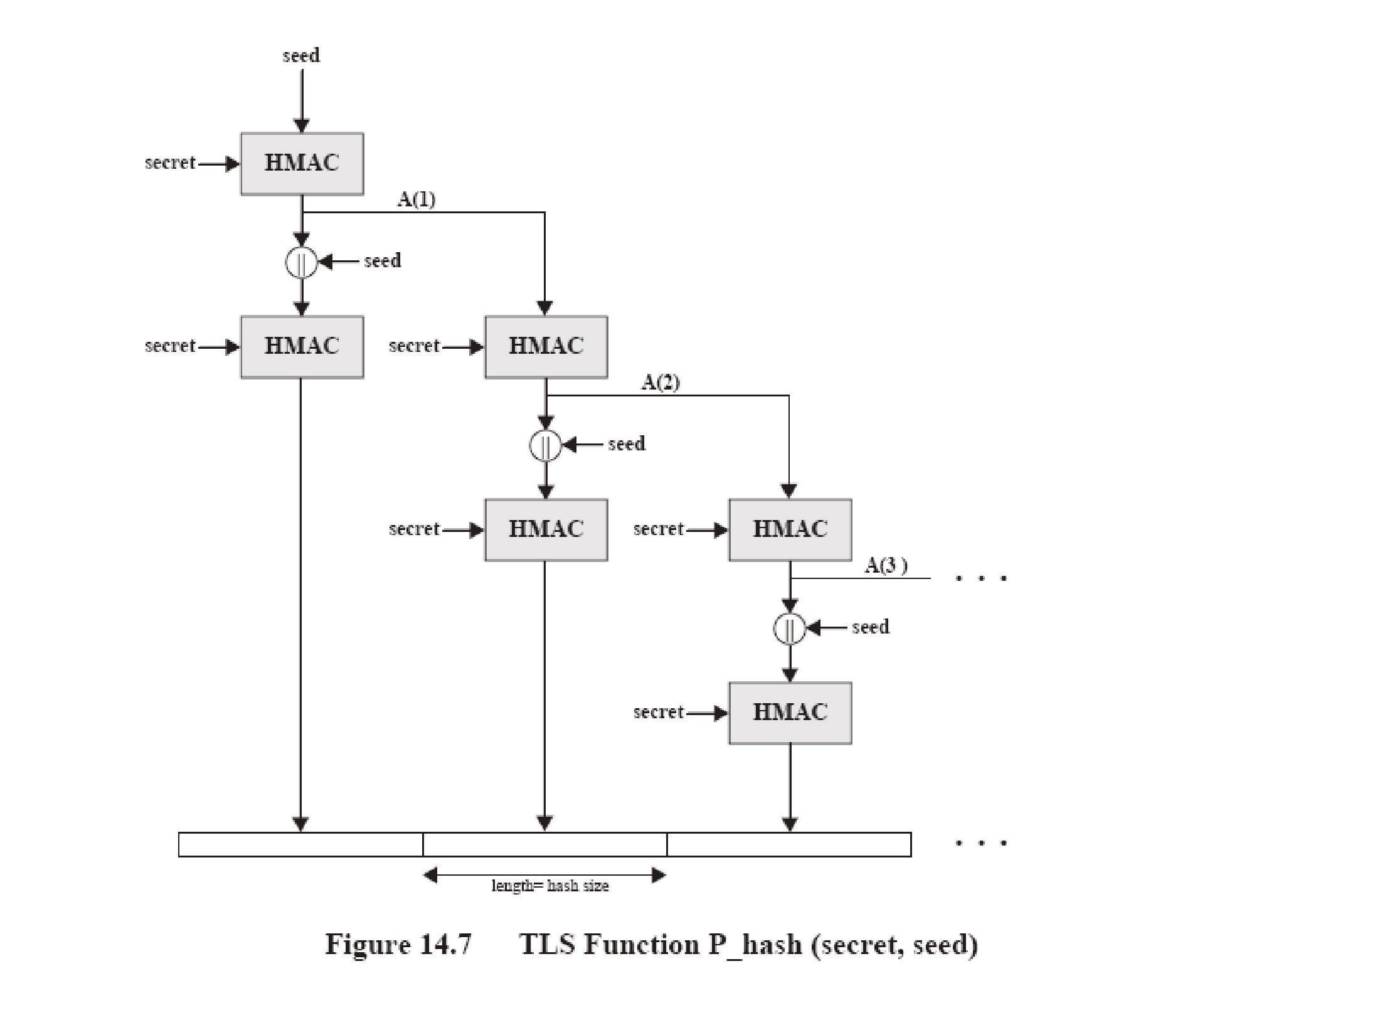

Slide 26
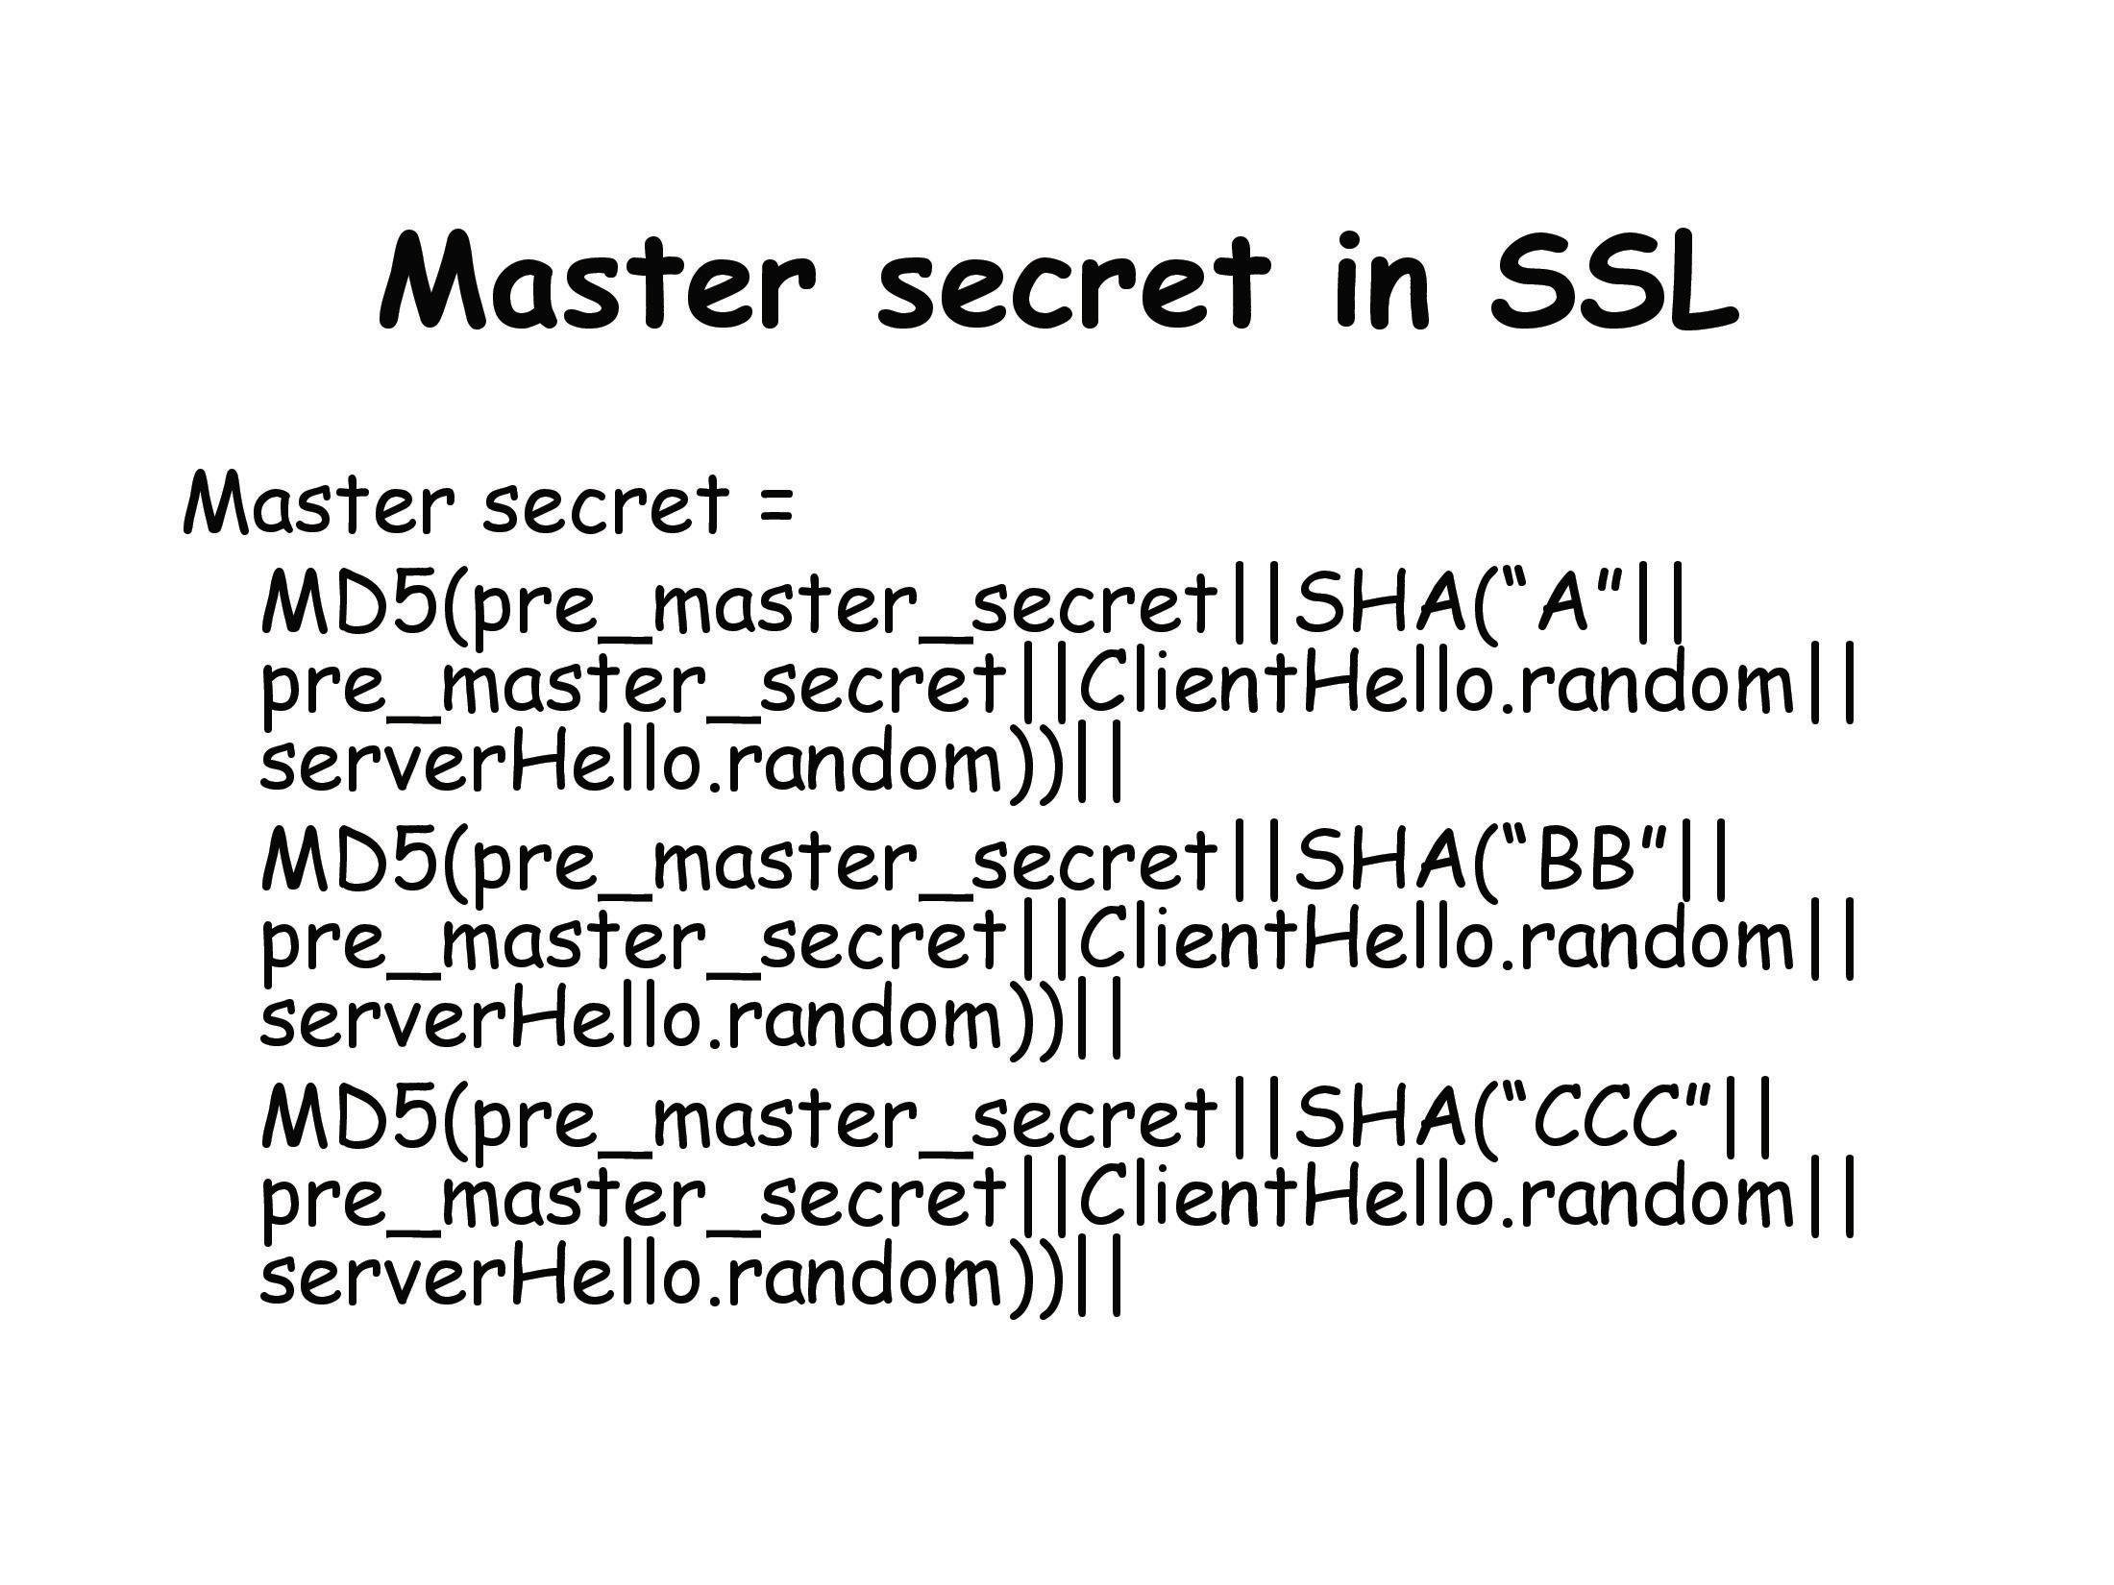

Slide 27
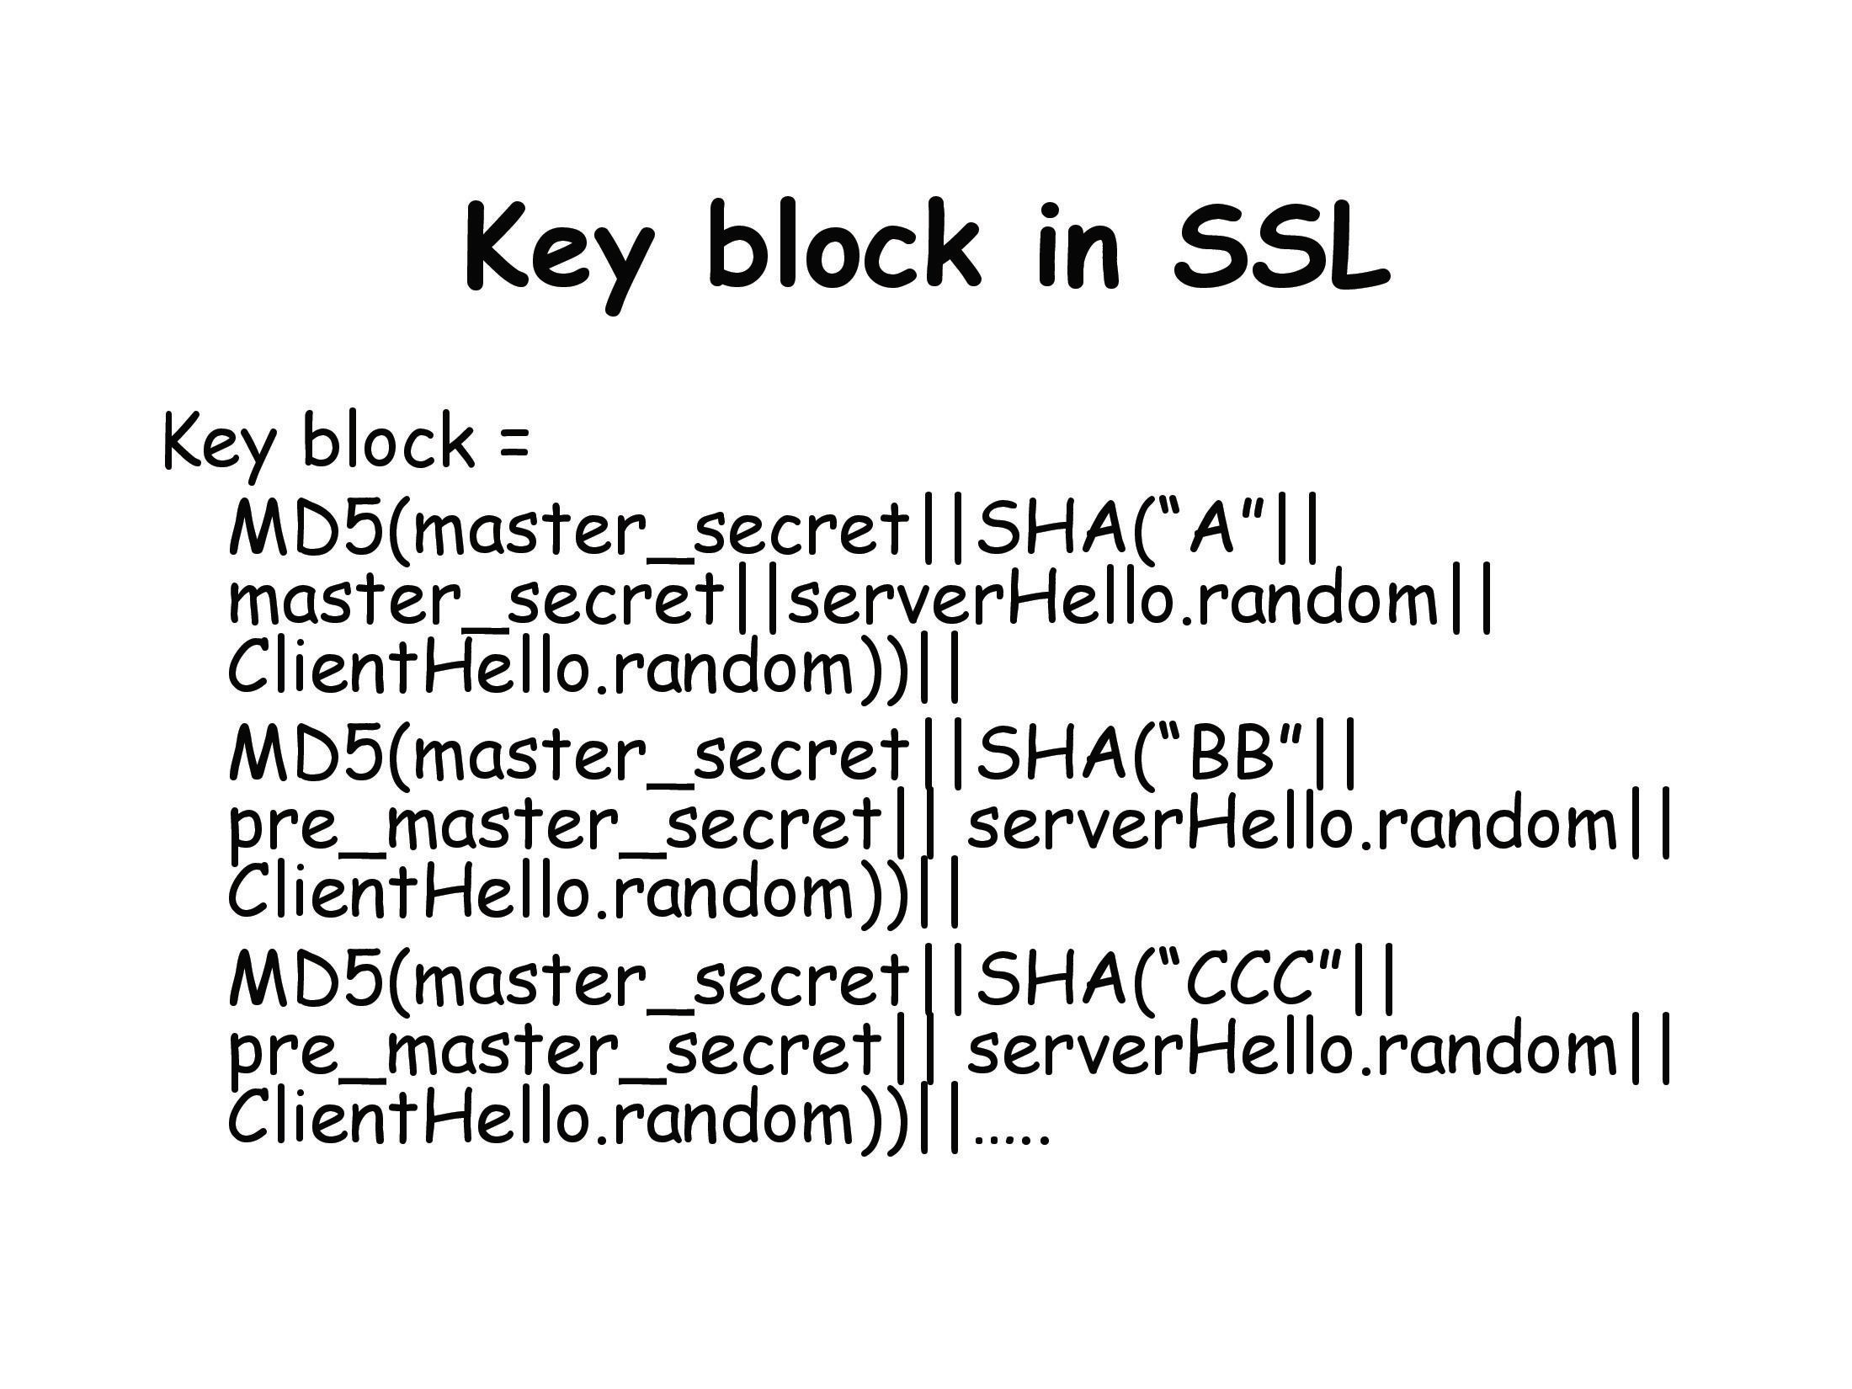

Slide 28
